Slide 1
Decision Tree
Presented by : Muhammad Zaqeem

Slide 2
Overview
Decision Tree
Structure of Decision Tree
Entropy
Information Gain
Building Decision Tree
Pruning

Slide 3
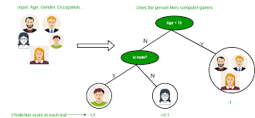
Decision Tree
Decision trees are a popular supervised machine learning algorithm that can be used for both regression and classification tasks.
Decision Trees (DTs) are a non-parametric supervised learning method
It’s called a "tree" because it has a structure similar to a tree in nature, with branches and nodes leading to different outcomes
Starting at a root node, it uses decision rules to split data at each internal node until reaching leaf nodes that provide the final prediction

Slide 4
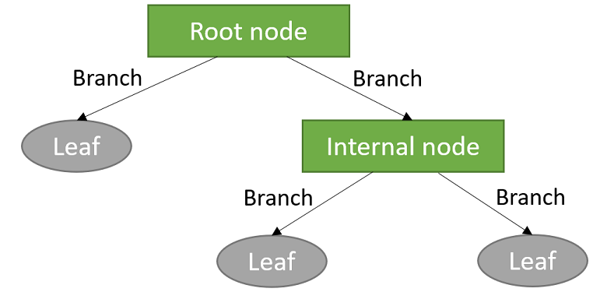
Structure of Decision Tree:
The structure of a Decision Tree resembles a flowchart, with three main types of nodes
Root Node: The topmost node in a decision tree. It represents the entire dataset, which is then split into two or more homogeneous sets.
Internal Nodes: Nodes that represent the features (attributes) tested to make decisions.
Leaf Nodes (Terminal Nodes): Nodes that represent the final decision or classification. These nodes do not split further.
Branches (Edges): To connect nodes.

Slide 5
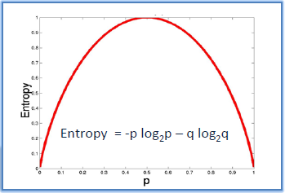
Entropy:
Entropy is a measure of disorder or impurity in the given dataset.
high entropy implies a higher level of disorder or uncertainty in the data. It suggests that the data is more heterogeneous, making it challenging for models to make accurate predictions.
In the decision tree, messy data are split based on values of the feature vector associated with each data point. With each split, the data becomes more homogenous which will decrease the entropy
It helps determine the best split for building an informative decision tree model.

Slide 6
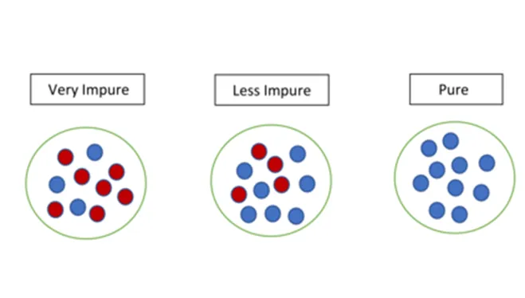
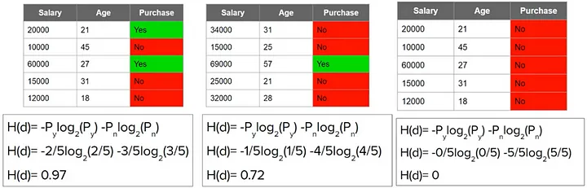

Slide 7
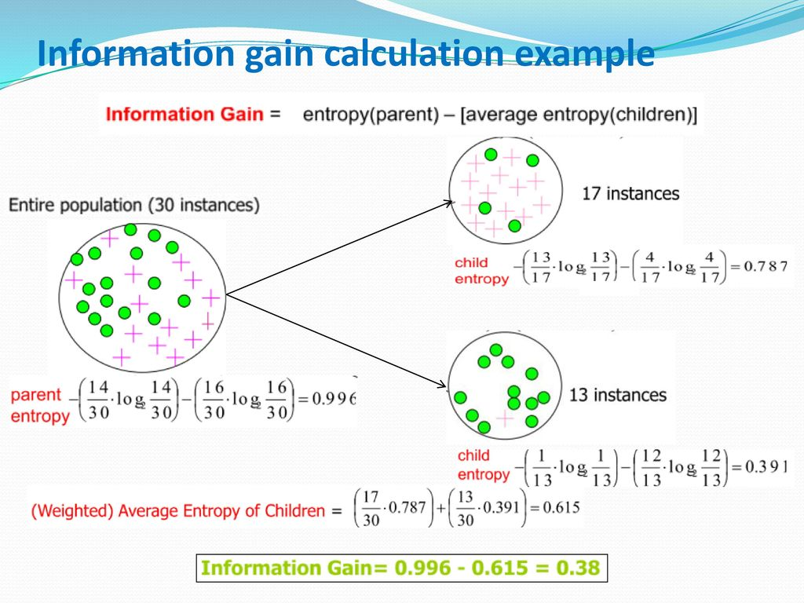
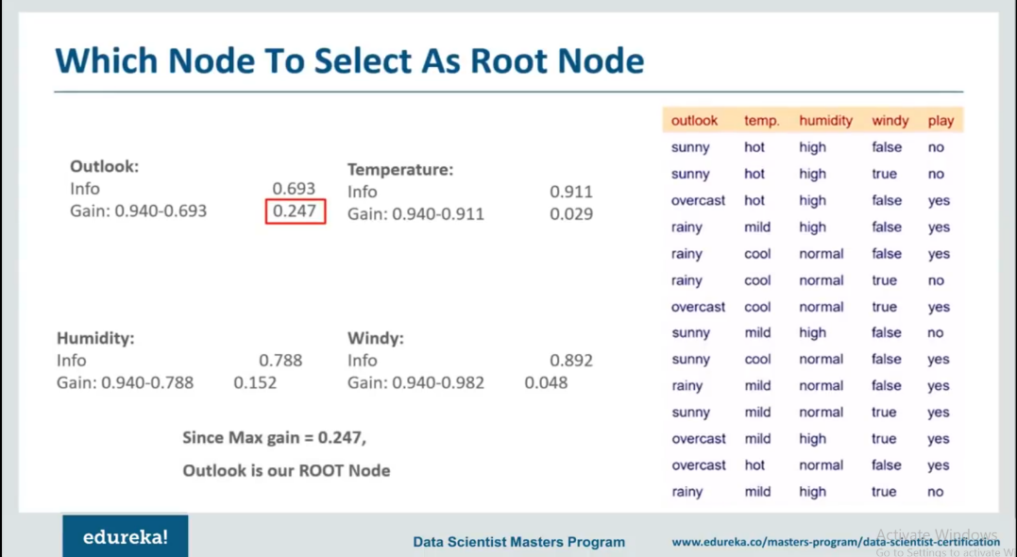
Information Gain:
The Information Gain measures the expected reduction in entropy.
Information gain measures reduction in impurity in the data. The feature which has minimum impurity will be considered as the root node.
Information gain is used to decide which feature to split on at each step in building the tree.
Information gain of a parent node can be calculated as the entropy of the parent node subtracted entropy of the weighted average of the child node

Slide 8
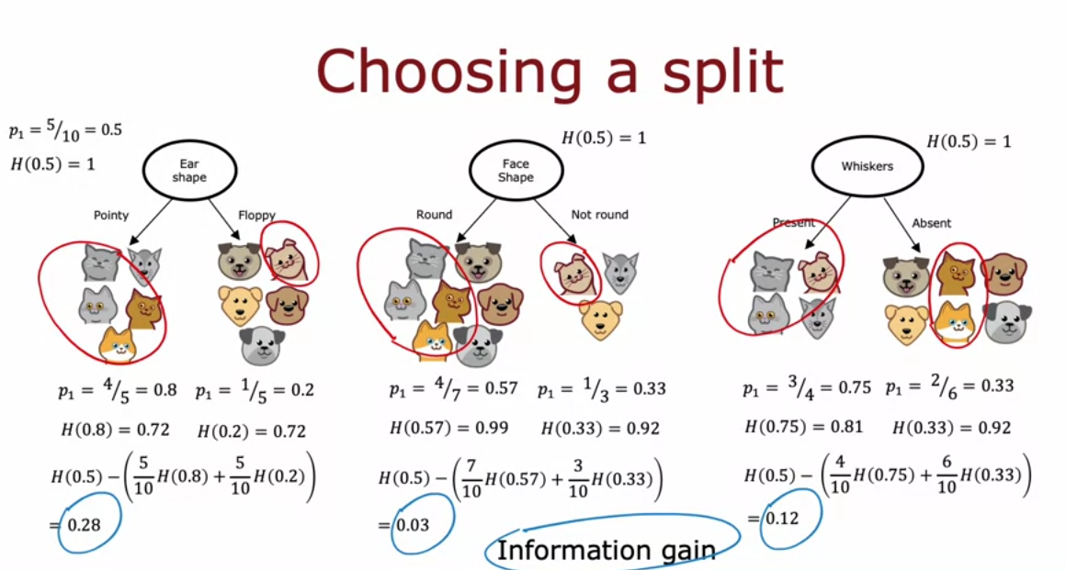

Slide 9
Building Decision Tree:
Select the Best Feature: Start by choosing the feature that best separates or classifies the data. we choose that feature which have high information gain
Split the Data: Divide the dataset based on the chosen feature's possible values, creating branches that represent the different outcomes of the feature.
Repeat for Each Branch: For each branch created, repeat the process by selecting the best feature to split on, further dividing the data until the data within each branch is as pure as possible (ideally, only one class remains).
Stop Splitting: Stop dividing branches when one of the stopping conditions is met—such as reaching maximum tree depth, having too few data points in a branch, or achieving zero impurity within a branch. The final branches are called leaf nodes.

Slide 10
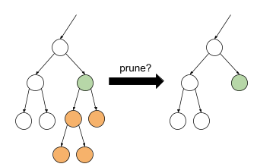
Pruning:
Pruning is a technique used to prevent decision trees from overfitting the training data
Pruning aims to simplify the decision tree by removing parts of it that do not provide significant predictive power, thus improving its ability to generalize to new data.
Pre-Pruning: In pre-pruning, we stop the tree from growing any further once a certain condition is met, even before the tree reaches its full depth.
Post-Pruning (Pruning After Training): In post-pruning, we first build the tree to its maximum depth and then prune it back.

Slide 11
Thank You

